Slide 1
CPU Scheduling
Gursharan Singh Tatla
professorgstatla@gmail.com
1-Feb-2011
www.eazynotes.com

Slide 2
CPU Scheduling
Scheduling refers to selecting a process, from many ready processes, that is to be next executed on CPU.
In multiprogramming environment, multiple processes are kept in main memory.
When one process has to wait for I/O completion, operating system takes the CPU from that process and assigns it to another process.
In this way, CPU is never idle and has some process to work on.
1-Feb-2011
www.eazynotes.com

Slide 3
Scheduler
Scheduler is an operating system module that selects the next job or process to be assigned to CPU.
Thus, scheduler selects one of the many processes in memory that are ready to execute and allocates CPU to it.
1-Feb-2011
www.eazynotes.com

Slide 4
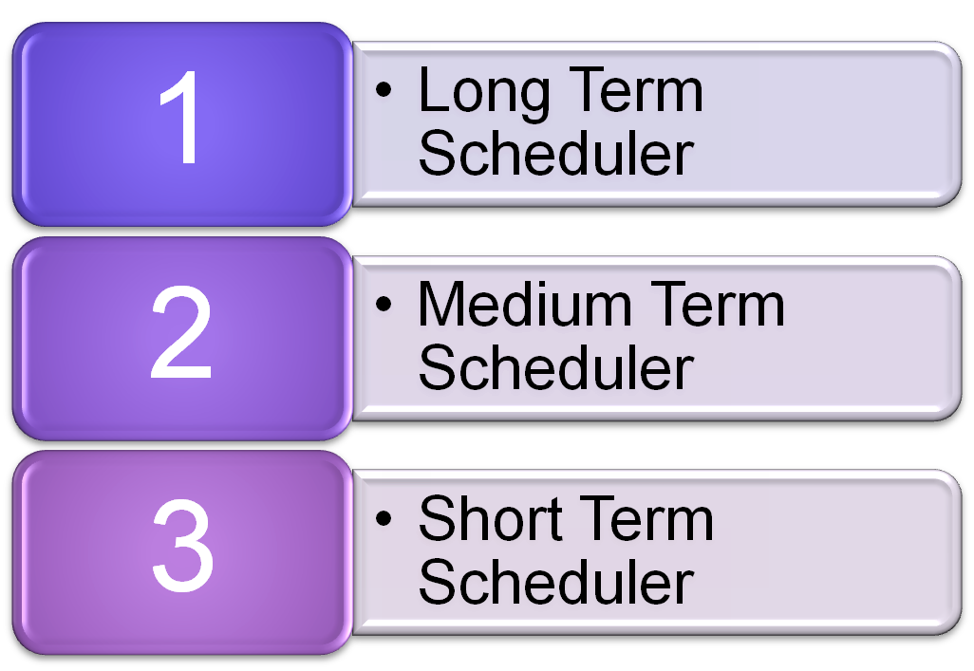
Scheduler
Scheduler is of three types:
1-Feb-2011
www.eazynotes.com

Slide 5
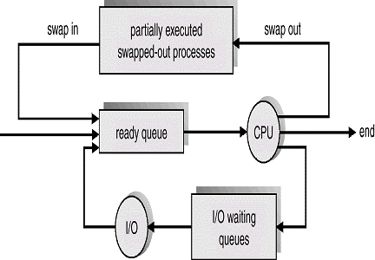
Scheduler
1-Feb-2011
www.eazynotes.com

Slide 6
Long Term Scheduler
Long Term Scheduler selects the processes from secondary storage and loads them into memory for execution.
It is called “long term” because the time for which the scheduling is valid is long.
The frequency of execution of a long term scheduler is usually low, as there may be minutes between the creation of new processes in the system.
1-Feb-2011
www.eazynotes.com

Slide 7
Long Term Scheduler
The primary objective of long term scheduler is to control the “degree of multiprogramming”.
Degree of multiprogramming refers to the total number of processes present in the memory.
If the degree of multiprogramming is stable, then the average rate of process creation is equal to the average terminate rate.
1-Feb-2011
www.eazynotes.com

Slide 8
Long Term Scheduler
This scheduler shows the best performance by selecting the good mixture of I/O bound and CPU bound processes.
I/O bound processes are those that spend most of their time in I/O.
CPU bound processes are those that spend most of their time in computations.
1-Feb-2011
www.eazynotes.com

Slide 9
Medium Term Scheduler
The medium term scheduler is required at the time when a swapped-out process is to be brought into pool of ready processes.
A running process may be suspended because of I/O request.
Such a suspended process is then removed from main memory and stored in secondary memory.
1-Feb-2011
www.eazynotes.com

Slide 10
Medium Term Scheduler
This is done because there is a limit on the number of active processes that can reside in main memory.
Therefore, a suspended process is swapped-out from main memory.
At some later time, the process can be swapped-in into the main memory.
All versions of Windows use swapping.
1-Feb-2011
www.eazynotes.com

Slide 11
Short Term Scheduler
Short term scheduler selects one process from many ready processes that are residing in main memory and allocates CPU to one of them.
Thus, it handles the scheduling of the processes that are in ready state.
Short term scheduler is also known as CPU Scheduler.
1-Feb-2011
www.eazynotes.com

Slide 12
Short Term Scheduler
As compared to long term scheduler, a short term scheduler has to work very often.
The frequency of execution of short term scheduler is high.
It must select a new process for CPU frequently.
1-Feb-2011
www.eazynotes.com

Slide 13
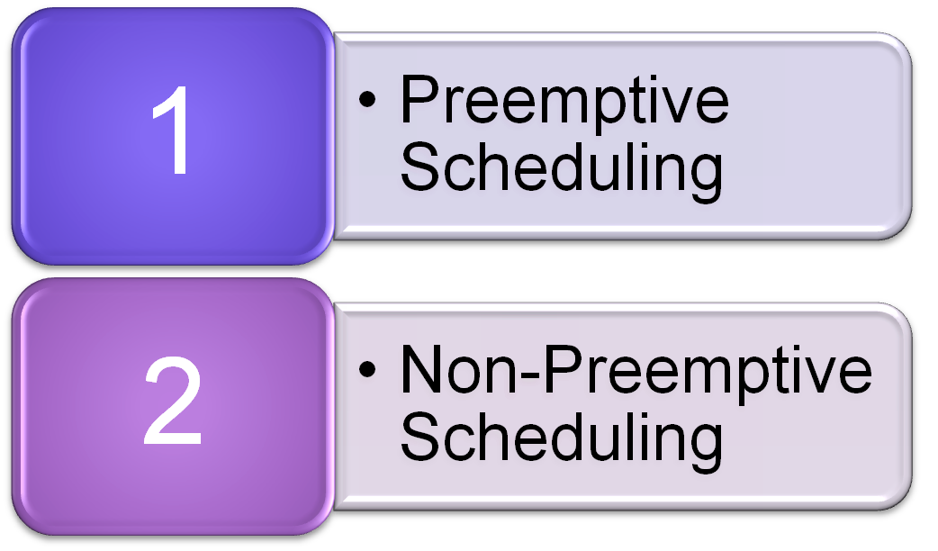
Preemptive & Non-Preemptive Scheduling
A scheduling algorithm can be:
1-Feb-2011
www.eazynotes.com

Slide 14
Non-Preemptive Scheduling
A scheduling is non-preemptive if, once a process has been given the CPU, the CPU cannot be taken away from the process.
In other words, in non-preemptive scheduling, once the CPU has been allocated to a process, the process keeps the CPU until it releases the CPU either by terminating or by entering the waiting state.
1-Feb-2011
www.eazynotes.com

Slide 15
Preemptive Scheduling
A scheduling is preemptive if the CPU can be taken away from a process after being allocated.
In other words, even if the CPU has been allocated to a certain process, it can be snatched from the process any time either due to time constraint or due to priority reason.
1-Feb-2011
www.eazynotes.com

Slide 16
Dispatcher
Dispatcher is a program responsible for assigning the CPU to the process, which has been selected by the short term scheduler.
Dispatching a process involves context switching.
1-Feb-2011
www.eazynotes.com

Slide 17
Scheduling Criteria
The goal of a scheduling algorithm is to identify the process whose selection will result in the best possible system performance.
The various scheduling criteria for evaluating an algorithm are discussed next.
1-Feb-2011
www.eazynotes.com

Slide 18
Scheduling Criteria
CPU Utilization:
  CPU utilization is the average fraction of time during which the processor is busy.
  The level of CPU utilization depends on the load on the system.
  CPU utilization may range from 0 to 100%.
1-Feb-2011
www.eazynotes.com

Slide 19
Scheduling Criteria
Throughput:
  It refers to the number of processes the system can execute in a period of time.
  For long processes, this rate may be 1 process per hour.
  For short processes, throughput may be 10 processes per second.
  Thus, evaluation of throughput depends on the average length of a process.
1-Feb-2011
www.eazynotes.com

Slide 20
Scheduling Criteria
Turnaround Time:
  This is the interval of time between the submission of a process and its completion.
  Thus, turnaround time is an average period of time it takes a process to execute.
  Turnaround time includes actual execution time plus time spent waiting for resources and doing I/O.
1-Feb-2011
www.eazynotes.com

Slide 21
Scheduling Criteria
Waiting Time:
  It is the average period of time a process spends waiting.
  Waiting time can be expressed as
  W(x) = T(x) – x
  where, W(x) is the waiting time
  T(x) is the turnaround time
  x is the actual execution time.
1-Feb-2011
www.eazynotes.com

Slide 22
Scheduling Algorithm Optimization Criteria
The optimization criteria is:
  Max. CPU Utilization
  Max. Throughput
  Min. Turnaround Time
  Min. Waiting Time
  Min. Response Time
1-Feb-2011
www.eazynotes.com

Slide 23



www.eazynotes.com

